Slide 1
LEAP-RE Kick-OFF MEETING 23-24 March 2021
Work Package WP2
Pillar 1 coordination

Slide 2
WP2: Introduction
WP2 focuses on activities required to ensure a effective implementation of Pillar 1, including: facilitation of dialogue between funders; seeking commitment for the successful launch of a long-term EU-AU partnership.
Objectives of this WP regarding Pillar 1 are:
Setting up of Pillar 1 governance structures (CSC: Call Steering Committee, JCS: Joint Call Secretariat)
Work planning, coordination of WP 7&8, and target setting
Administrative and financial management of the projects minimizing costs
Management of gender issues and ethics
Quality control of the work performed and deliverables
Monitoring results regarding fulfilment of the planned objectives
Management of Pillar 1 partners, conflict resolution
WP duration: M1-M60
Partners involved:
Task Leaders: ANR & MESRS
Contributors: DSI, LU, MENFPESRS, ASRT, IRESEN, Univ Lomé, SANEDI, AKA, FRS-FNRS, FZJ-PtJ, FFG, FCT, CDTI, NEXA, UEFISCDI,

Slide 3
WP2 Main Milestones
Milestone number | Milestone title | Lead | Date
MS 1 | Launch of 1st Call* | ANR | M6
MS 2 | Workshop 1 | UH | M21
MS 3 | Workshop 2 | AESG | M45
MS 4 | Workshop 3 | UH | M61
MS 7 | Decision on the launch of second call | ANR | M15
* Launched on January 15th 2021

Slide 4
WP 2 Task 2.1
Task 2.1: Setting up the Call Steering Committee
(Task Leader: ANR, MESRS)
M1 to M3
This task was dedicated to set up the CSC and organise the first meeting:
Define the Pillar 1 calls governance structures and operating rules
Coordinate communication actions on the co-funded calls
Decision on EC allocation Top Up
After this 1st CSC meeting, WP2 leaders will be responsible for organizing the following Pillar 1 governance meetings as foreseen in the timetable of the project.
Task completed : Pillar 1 kick-off meeting on October 15th 2020 + 3 meeting of CSC (17-11-202, 14-12-2020, 11-01-2021)
Call pre-announcement in October 2020, Call publication on 15th January 2021

Slide 5
WP 2 Task 2.2
Task 2.2: Pillar 1 administrative and financial management
(Task Leader: ANR, MESRS, Contributors: LU, DSI)
M1 to M 60
The administrative and financial management will be handled by the Joint Call Secretariat (JCS), in coordination with the CSC. This task ensures that all administrative and financial obligations are fully met.
To achieve these objectives, the JCS will design and implement management tools such as calls planning, quality plan, KPIs, risk management plan, reporting, etc. This task involves the following:
Internal communication management and day-to-day management
Periodic reporting and document production and archiving
Co-ordination and consolidation of annual cost claims by all project partners, under WP1 guidance
Monitoring project costs in order to predict, oversee and control the costs incurred and grant funding globally, by WP and by participants; monitor grant usage
Under the guidance of WP1, coordinate with P1 projects to collect financial reports
Oversight of the application of the consortium agreement
Support to individual partners on specific administrative and financial issues
Liaise with the PMB for any relevant issues
LU will be specifically in charge of the administrative and financial management of beneficiaries from African countries not represented by a national agency in the CSC.

Slide 6
WP 2 Task 2.3
Task 2.3: Pillar 1 technical coordination
(Task Leader: ANR, MESRS, Contributors: LU, DSI)
M1-M 60
This task will coordinate the Pillar 1 tasks implementation. It will oversee the timely implementation of all the co-fund calls tasks, while keeping focus on the key objectives of the LEAP-RE:
Drafting of the Detailed Work Plan for Pillar 1 (under the guidance of WP1)
Planning and organization of Pillar 1 governance structures meetings
Developing management framework to support the Pillar 1 governing structures
Coordinating and creating linkages among all the WPs and Pillar activities
Monitoring activities, results and risks; take proactive actions to avoid deviations
Preparation of technical reports and deliverables in liaison with WP 7&8
Implementing quality control procedure for project output
Monitoring application of Gender Action Plan (WP1) and respect of ethical guidelines set by Pillar 1
Support the establishment of the International Review Panel envisaged within WP7
Evaluation of the co-fund call procedures to provide input for potential future calls
Management of the Funders Mirror Group (FMG), with the purpose to expand the dialogue with other agencies and ministries, not partners in LEAP-RE

Slide 7
WP 2 Task 2.4
Task 2.4: Managing Pillar 1 communication flows
(Task Leader: ANR, MESRS)
M1- M60
Ensuring efficient communication within Pillar 1 and with the International Review Panel
Ensuring efficient communication with other Pillars and the LEAP-RE community
Represent Pillar 1 and its partners, and liaise with the PMB, and on a case by case basis and in accordance with the coordinators, dialogue with the EC and institutional third parties.
The co-leadership between ANR and MESRS will ensure joint ownership of the calls. It will also facilitate on the ground contacts with African and European stakeholders.

Slide 8
LEAP-RE Kick-OFF MEETING 23-24 March 2021
Work Package 7
Managing calls and selecting R&I projects

Slide 9
WP7: Introduction
Objectives of this WP7 are:
Prepare and launch one or more transnational calls with EC co-funding
Implement the calls evaluation, with scoring, ranking and funding decisions;
manage the two-stage evaluation process, including the EU and national eligibility checks;
manage international peer review
Ensure contracting arrangements between selected project participants and their funding party
WP7 duration: M1-M60
Partners involved: Coordinators: ANR (France) & MESRS (Algeria)
Contributors: MENFPESRS (Morocco), IRESEN (Morocco), ASRT (Egypt), DSI (South Africa), SANEDI (South Africa), Université de Lomé (Togo), FRS-FNRS (Belgium), AKA (Finland), NEXA (France), FZJ-PtJ (Germany), FCT (Portugal), UEFISCDI (Romania), CDTI (Spain), Loughborough University (UK).

Slide 10
WP7: Completed Actions since Pilar1 KoM (15/10)
Task 7.1 Joint establishment of thematic priorities (MAR)
The range of activities focus on 6 identified multi-annual roadmaps. Overall, LEAP-RE Joint Call 2021 will fund basic research, applied research and experimental development projects that are 12-36 months long. The pre-announcement call was launched in 15th October during Pillar1 KoM.
Task 7.2 Design and preparation of the first co-funded call
Many meetings were organised with funding agencies to identify national eligibility criteria (TRL, MAR, ..) and to finalise the call text
Task 7.3 Providing the electronic submission tool system (ANR)
The ANR implemented the portal for submission
Task 7.4 Launch of the call: January 15th, publication of the Call text
Since three meeting of coordination and explanation were organised with researchers and the funding agencies. We provided explanations through emails.
Task 7.5 International Expert Panel : We received proposals for more than 50 experts, from 8 countries among them 30 filled the expert template and are eligible to the IRP.

Slide 11
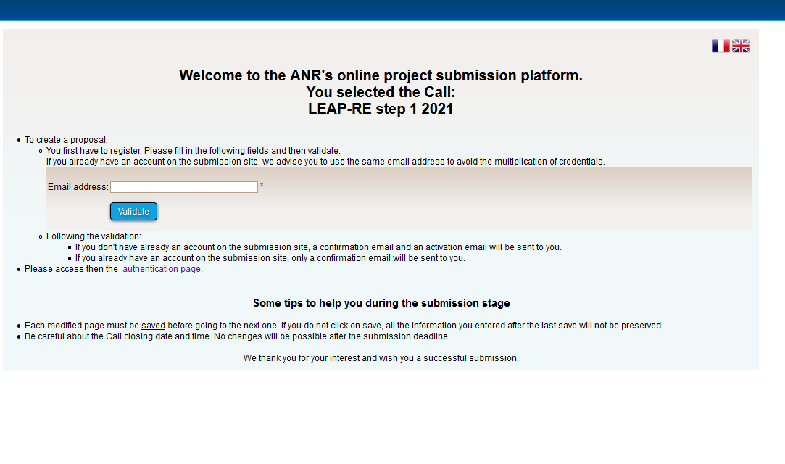
WP7: Completed Actions since Pilar1 KoM (15/10)
Providing the electronic submission portal (ANR)
Int. Review Panel

Slide 12
WP7: Selection process
The International Review Panel (IRP) gathering independent experts will evaluate and rank the projects (> 85 projects already submitted); conditions: confidentiality, declaration to notify cases of conflict of interest, declaration concerning the delivery of assessments and reports in due time);
The evaluation criteria are :
scientific excellence,
impact,
quality and efficiency on the implementation
The ranking list of projects evaluated by the IRP will be used as a recommendation by Funding Agencies;
Consortia involving both academic and industrial organisations or Non-Governmental Organisations are particularly encouraged to apply (however national regulations governing eligibility may restrict the eligibility of applicants in specific countries).
LEAP-RE Joint Call 2021 supports gender equality, therefore applicants should consider gender equality and gender issues wherever possible.

Slide 13
WP7: Two steps selection system
Task 7.6 and Task 7.7 A two steps submission/selection process : a pre-submission/preselection/full-submission/final selection
Task 7.8: Funding decision and use of EC contribution M12 to M14
Selected applicants will sign funding contracts with the respective national/regional funding agencies. - Preparation of the request to the EC for top-up.
Task 7.9: Implementation of a possible second co-fund call
This second call will be implemented by following the same methodology than the first call, i.e. as indicated in Tasks 7.4 to 7.8.
15 January 2021 | Publication of the Call
1st April 2021, 17:00:00 CEST | Deadline for Pre-proposal submission (mandatory)
15 June 2021 | Communication of pre-proposal assessment
15 September 2021, 17:00:00 CEST | Deadline for Full Proposal submission
30 November 2021 | Communication of full-proposal assessment

Slide 14
WP7: Deliverables
D7.1 Call text (ANR, M3, R, PU)
D7.2 Call documents (ANR, M3, R, PU)
D7.3 Electronic submission tool (ANR, M3, R, PU)
D7.4 Ranking list from the pre-proposal evaluation of first co-funded call (MESRS, M9, R, PU)
D7.5 Ranking list from the full proposal evaluation of first co-funded call (ANR, M14, R, PU)
D7.6 Joint selection list and report of the projects to be funded (first co-funded call, ANR, M15, R, PU)
D7.7 Ranking list from the pre-proposal evaluation of second co-funded call (MESRS, M18, R, PU)
D7.8 Ranking list from the full proposal evaluation of second co-funded call (ANR, M22, R, PU)
D7.9 Joint selection list & report of the projects to be funded (snd co-funded call (ANR, M23, R, PU)

Slide 15
WP7:Risk assessment
Risk assessment and Contingency plan
Risk Name | Impact if occurs | Preventive / Contingency action
Confusion RIA-ERANET | High | Providing explanation by different means
Project manager are not aware of national eligibility criteria | High | Providing explanation by different means
Proposal including only African partners without funding agencies | Medium | Providing explanation by different means

Slide 16
LEAP-RE Kick-OFF MEETING 23-24 March 2021
Work Package 8 Monitoring of call outputs and projects

Slide 17
WP 8: Introduction
The objectives of WP8 are to:
assess the outputs of the first co-funded call (number of projects, topics covered and allocated funding)
decide whether to implement or not a second co-fund call
define project monitoring indicators that fulfil national/regional and Horizon 2020 criteria
monitor project progress and reports
perform projects evaluation
WP duration: M1-M60
Partners involved:
Task Leaders: ANR & MESRS
Contributors: DSI, LU, MENFPESRS, ASRT, IRESEN, Univ Lomé, SANEDI, AKA, FRS-FNRS, FZJ-PtJ, FFG, FCT, CDTI, NEXA, UEFISCDI, SANEDI

Slide 18
WP 8 Objectives and description
Results of the first co-fund call in terms of number of funded projects and spent EC contribution will be assessed, in order to decide if a second co-fund call is possible and necessary. If the Call Steering Committee agrees on holding a second co-fund call, this last one will be performed with the same methodology of the first one described in WP7.
All funded projects will be monitored in their scientific and financial implementation, to ensure a correct use of funding and the achievement of the scientific results on which projects selection was based. WP8 tasks leaders will follow a common methodology, complying with EC rule’s for projects monitoring.
Researchers will be required to submit during the proposal stage expected outputs (e.g. transnational activities, dissemination activities, publication of scientific and grey literature, discovery and development of innovative products, processes and know-how and evidence of uptake) during the lifetime of each project as indicators of success within their impact plans.
Reports will be expected to include evidence of impact. This information will be used to assess overall impact of LEAP-RE at mid-term and on completion. Presentations will be given at the mid-term and final seminars, within WP 4 (under Pillar 3).

Slide 19
WP 8 Task 8.1, 8.2
Task 8.1: Define indicators to assess the first co-fund call
(Task Leader: ANR, MESRS, Contributors: FZJ-PtJ, IRESEN)
M1 to M 63
Indicators about the outputs of the first co-fund call will be considered by the CSC since its first meeting, namely the amount national/regional commitments pooled, the part of EC contribution spent, the number of projects funded as well as their distribution in terms of countries and topics.
Task 8.2: Decision on second co-fund call (Task Leader: ANR, MESRS)
M1 to M15
After the first co-funded call, a dedicated meeting of the CSC will be held, in order to evaluate the possibility of further commitments of partner funding agencies for a second call, also with respect to the remaining EC contribution. A consensus decision will be taken about this second call

Slide 20
WP 8 Task 8.3
Task 8.3: Define indicators for the monitoring and evaluation of projects
(Task Leader: FFG, IRESEN, Contributing partners: UEFISCDI, LU)
M14 to M15
A list of indicators will be defined, in accordance to WP5, to monitor and evaluate the co-funded projects. The CSC will contribute to the development of the monitoring and evaluation indicators relevant to the objectives of LEAP-RE and the co-funded projects, as well as adherent to national requirements and fulfil Horizon 2020 criteria.
Three categories of indicators will be elaborated:
-scientific and technical results;
-economic effects;
-transnational benefits.
A focus will be put on assessing the contribution of projects to capacity building. The selected indicators will be embedded in the design of the reporting forms/procedures to be used in the follow-up and monitoring of the projects funded under the co-funded call. The data gathered will be used for project monitoring, evaluation and impact assessment under WP5

Slide 21
WP 8 Task 8.4
Task 8.4: Reporting and monitoring procedures
Task Leader: UEFISCDI, MESRS, Contributing partners: FFG, LU
M16 to M60
The project coordinators will be notified to do a reporting in order to allow for monitoring requirements. To this purpose, appropriate report templates will be developed, to be uploaded in the online call management tool. Abstracts for publication highlighting the preliminary results of the mid-term reports and results of the final reports will also be available to support WP 4.
A kickoff meeting of the selected projects, and a mid-term Review Seminar, with presentations by the project coordinators will be held, in cooperation with WP4.
The project coordinators will present the results from the mid-term report including indicators and the progress of the projects according to the milestones and deliverables defined in the proposals in the online tool. The mid-term review evaluation panel with selected members of the IRP with expertise in the field of the funded projects will evaluate the reported progress and prepare a short-written report to the CSC, with a part transmissible to the consortia for feedback.

Slide 22
WP 8 Task 8.5
Task 8.5: Scientific and impact assessment of co-funded projects
Task Leader: ANR, MESRS, Contributing partners: FFG, UEFISCDI
M36 to M60
The impact of the co-funded call will be analyzed by assessing all funded projects. Monitoring results from the final reports will be presented to the CSC for final assessment, to be shared with WP5.
The final scientific evaluation of funded Pillar 1 projects will be based on the final project reports and presentations made by the project coordinators at a LEAP-RE General Workshop, in cooperation with WP4 and open to invited stakeholders.
An Evaluation Panel composed by selected CSC members, the IRP chair and Vice-chair and two other members, with expertise covering all the main themes, will perform the scientific assessment. This board will complete an evaluation form for each project, indicating the advances and contributions of the funded projects with respect to the LEAP-RE Multi-Annual Roadmaps.
A final report of co-funded projects will summarise the monitoring, evaluation and impact assessment results. This report will be presented to the CSC and will be used in support to WP5 and WP6 for long term impact. It will be included in the final report to the EC.

